Slide 1


Day 13
Math24 (Differential Equations)
Ch 2.7 Numerical Approximations: Euler’s Method (Page 102-112)
Elementary Differential Equations and Boundary Value Problems, 10th edition, by William E. Boyce and Richard C. DiPrima, ©2013 by John Wiley & Sons, Inc.

Slide 2
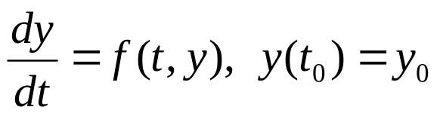
Recall that a first order initial value problem has the form
If f and ∂f /∂y are continuous, then this IVP has a unique solution y = φ(t) in some interval about t₀.
When the differential equation is linear, separable or exact, we can find the solution by symbolic manipulations.
However, the solutions for most differential equations of this form cannot be found by analytical means.
Therefore it is important to be able to approach the problem in other ways.

Slide 3

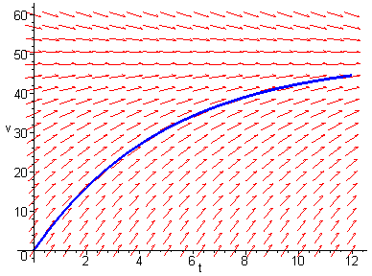
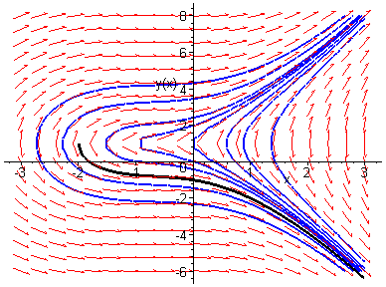
Direction Fields
For the first order initial value problem
we can sketch a direction field and visualize the behavior of solutions. This has the advantage of being a relatively simple process, even for complicated equations. However, direction fields do not lend themselves to quantitative computations or comparisons.

Slide 4
Numerical Methods
For our first order initial value problem
an alternative is to compute approximate values of the solution y = φ(t) at a selected set of t-values.
Ideally, the approximate solution values will be accompanied by error bounds that ensure the level of accuracy.
There are many numerical methods that produce numerical approximations to solutions of differential equations, some of which are discussed in Chapter 8.
In this section, we examine the tangent line method, which is also called Euler’s Method.

Slide 5

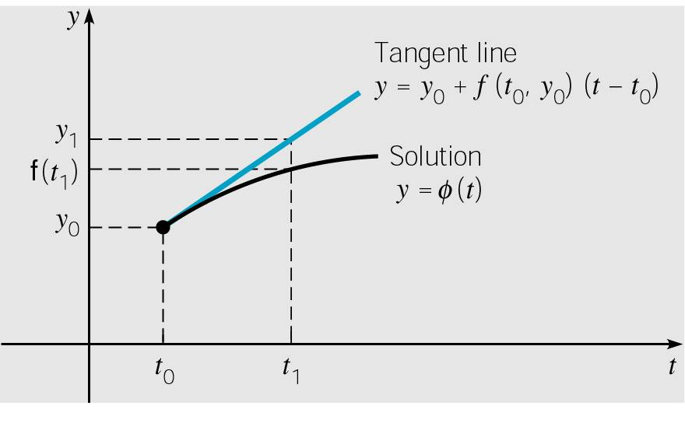

Euler’s Method: Tangent Line Approximation
For the initial value problem
we begin by approximating solution y = φ(t) at initial point t₀.
The solution passes through initial point (t₀, y₀) with slope
f (t₀, y₀). The line tangent to the solution at this initial point is
The tangent line is a good approximation to solution curve on an interval short enough.
Thus if t₁ is close enough to t₀,
we can approximate φ(t₁) by

Slide 6

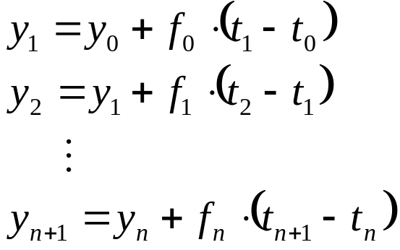

Euler’s Formula
For a point t₂ close to t₁, we approximate φ(t₂) using the line passing through (t₁, y₁) with slope f (t₁, y₁):
Thus we create a sequence y_{n} of approximations to φ(t_{n}):
where f_{n} = f (t_{n}, y_{n}).
For a uniform step size h = t_{n} – t_{n-1}, Euler’s formula becomes

Slide 7
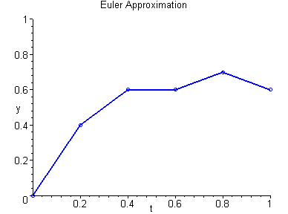
Euler Approximation
To graph an Euler approximation, we plot the points
(t₀, y₀), (t₁, y₁),…, (t_{n}, y_{n}), and then connect these points with line segments.

Slide 8
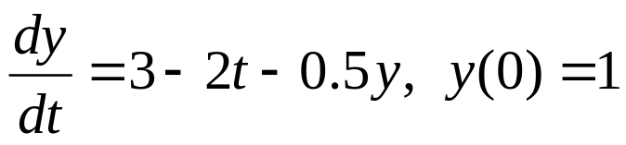
Example 1: Euler’s Method (1 of 3)
For the initial value problem
we can use Euler’s method with h = 0.2 to approximate the solution at t = 0.2, 0.4, 0.6, 0.8, and 1.0 as shown below.

Slide 9


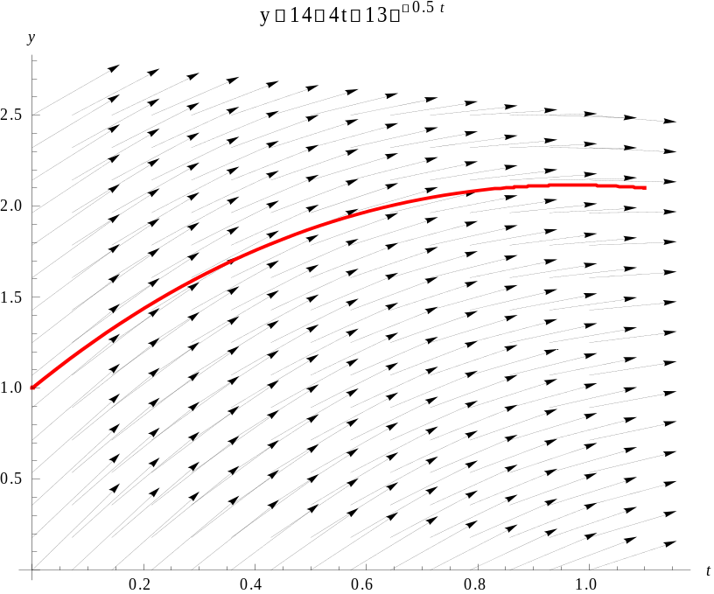

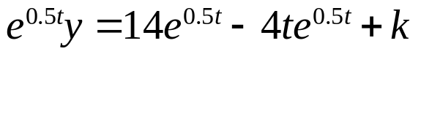



Example 1: Exact Solution (2 of 3)
We can find the exact solution to our IVP, as in Chapter 2.1:

Slide 10
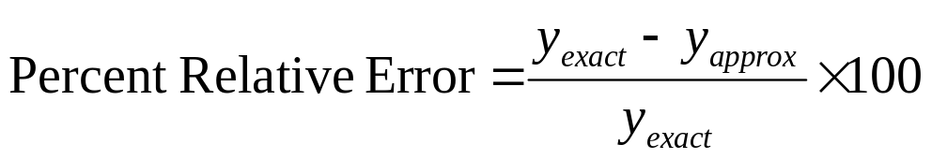
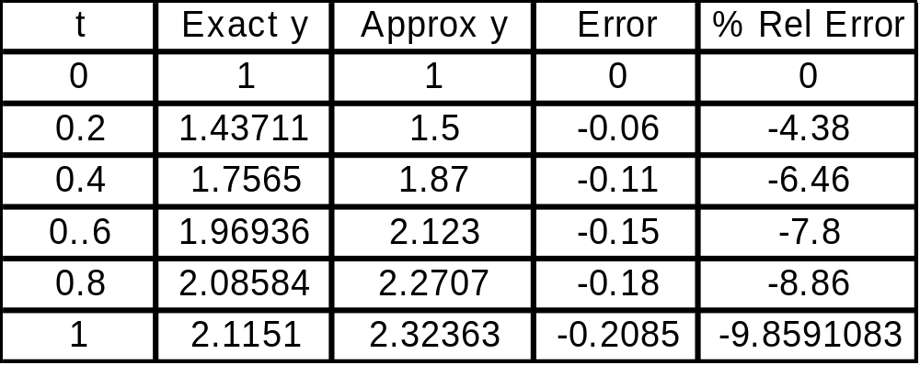
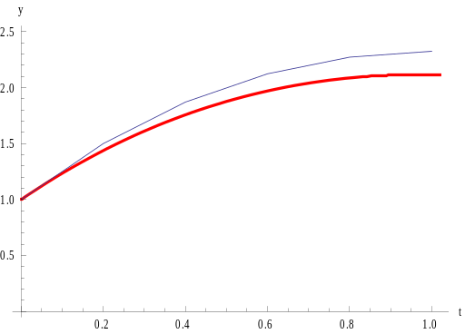
Example 1: Error Analysis (3 of 3)
From table below, we see that the errors start small, but get larger. This is most likely due to the fact that the exact solution is not linear on [0, 1]. Note:
Exact y in red
Approximate y in blue

Slide 11

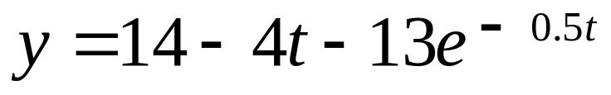
Example 2: Euler’s Method (1 of 3)
For the initial value problem
we can use Euler’s method with various step sizes to approximate the solution at t = 1.0, 2.0, 3.0, 4.0, and 5.0 and compare our results to the exact solution
at those values of t.

Slide 12
Example 2: Euler’s Method (2 of 3)
Comparison of exact solution with Euler’s Method for h = 0.1, 0.05, 0.25, 0.01
t | Exact y | h = 0.1 | h = 0.05 | h = 0.025 | h = 0.01
0.0 | 1.0000 | 1.0000 | 1.0000 | 1.0000 | 1.0000
1.0 | 2.1151 | 2.2164 | 2.1651 | 2.1399 | 2.1250
2.0 | 1.2176 | 1.3397 | 1.2780 | 1.2476 | 1.2295
3.0 | -0.9007 | -0.7903 | -0.8459 | -0.8734 | -0.8898
4.0 | -3.7594 | -3.6707 | -3.7152 | -3.7373 | -3.7506
5.0 | -7.0671 | -7.0337 | -7.0337 | -7.0504 | -7.0604

Slide 13
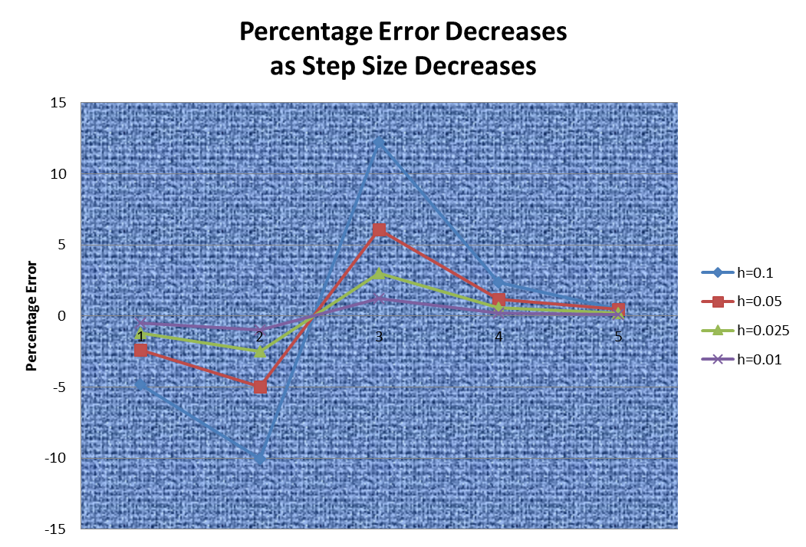
Example 2: Euler’s Method (3 of 3)

Slide 14
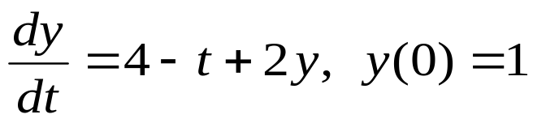

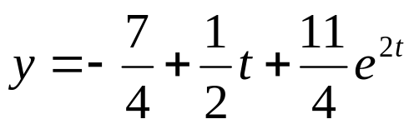
Example 3: Euler’s Method (1 of 3)
For the initial value problem
we can use Euler’s method with h = 0.1 to approximate the solution at t = 1, 2, 3, and 4, as shown below.
Exact solution (see Chapter 2.1):

Slide 15
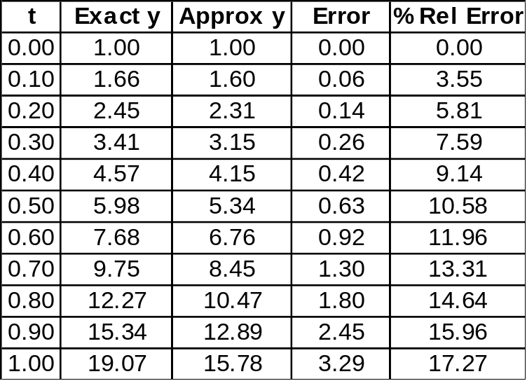
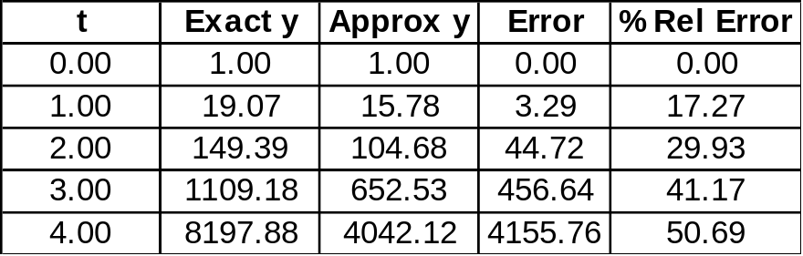
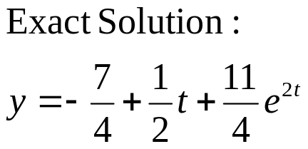
Example 3: Error Analysis (2 of 3)
The first ten Euler approxs are given in table below on left. A table of approximations for t = 0, 1, 2, 3 is given on right. See text for numerical results with h = 0.05, 0.025, 0.01.
The errors are small initially, but quickly reach an unacceptable level. This suggests a nonlinear solution.

Slide 16

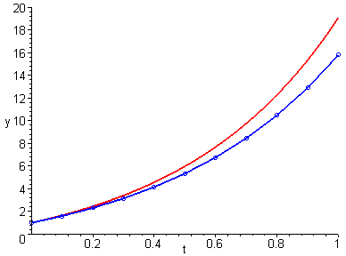
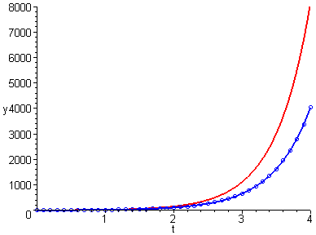
Example 3: Error Analysis & Graphs (3 of 3)
Given below are graphs showing the exact solution (red) plotted together with the Euler approximation (blue).

Slide 17
General Error Analysis Discussion (1 of 4)
Recall that if f and ∂f /∂y are continuous, then our first order initial value problem
has a solution y = φ(t) in some interval about t₀.
In fact, the equation has infinitely many solutions, each one indexed by a constant c determined by the initial condition.
Thus φ is the member of an infinite family of solutions that satisfies φ(t₀) = y₀.

Slide 18
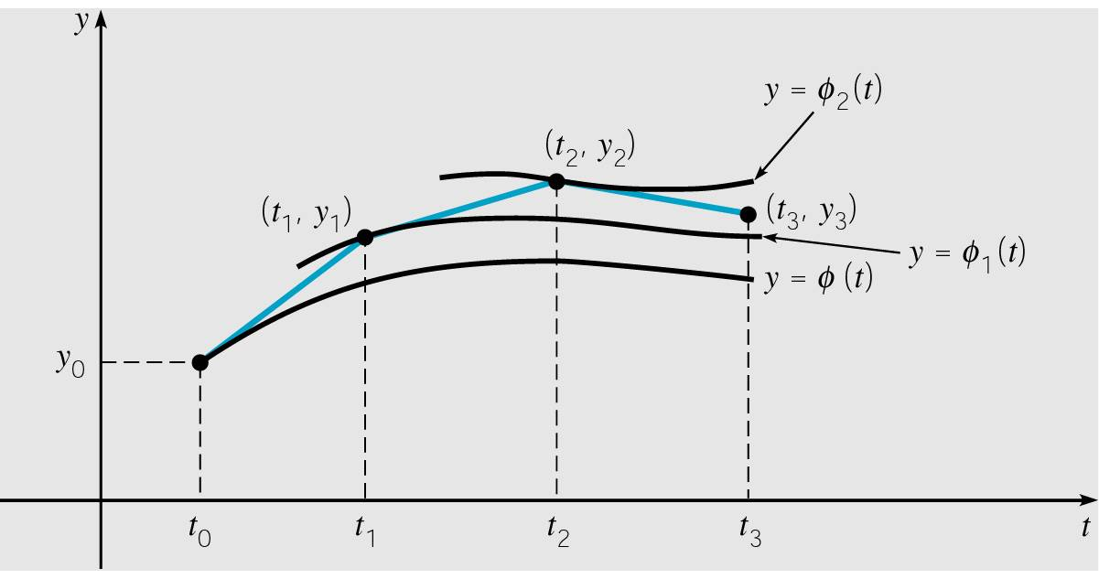
General Error Analysis Discussion (2 of 4)
The first step of Euler’s method uses the tangent line to φ at the point (t₀, y₀) in order to estimate φ(t₁) with y₁.
The point (t₁, y₁) is typically not on the graph of φ, because y₁ is an approximation of φ(t₁).
Thus the next iteration of Euler’s method does not use a tangent line approximation to φ, but rather to a nearby solution φ₁ that passes through the point (t₁, y₁).
Thus Euler’s method uses a
succession of tangent lines
to a sequence of different
solutions φ, φ₁, φ₂,… of the
differential equation.

Slide 19
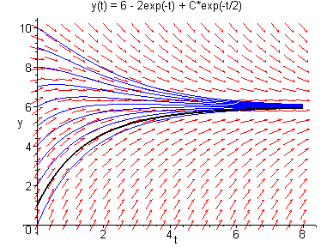
Error Analysis Example:
Converging Family of Solutions (3 of 4)
Since Euler’s method uses tangent lines to a sequence of different solutions, the accuracy after many steps depends on behavior of solutions passing through (t_{n}, y_{n}), n = 1, 2, 3, …
For example, consider the following initial value problem:
The direction field and graphs of a few solution curves are given below. Note that it doesn’t matter which solutions we are approximating with tangent lines, as all solutions get closer to each other as t increases.
Results of using Euler’s method
for this equation are given in text.

Slide 20
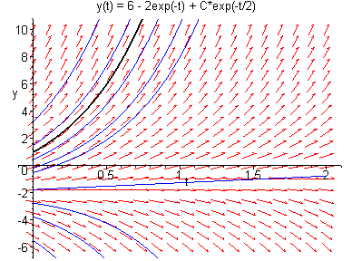
Error Analysis Example:
Divergent Family of Solutions (4 of 4)
Now consider the initial value problem for Example 2:
The direction field and graphs of solution curves are given below. Since the family of solutions is divergent, at each step of Euler’s method we are following a different solution than the previous step, with each solution separating from the desired one more and more as t increases.

Slide 21
Error Bounds and Numerical Methods
In using a numerical procedure, keep in mind the question of whether the results are accurate enough to be useful.
In our examples, we compared approximations with exact solutions. However, numerical procedures are usually used when an exact solution is not available. What is needed are bounds for (or estimates of) errors, which do not require knowledge of exact solution. More discussion on these issues and other numerical methods is given in Chapter 8.
Since numerical approximations ideally reflect behavior of solution, a member of a diverging family of solutions is harder to approximate than a member of a converging family.
Also, direction fields are often a relatively easy first step in understanding behavior of solutions.

